Slide 1
Project 1:
Building and Securing a Small Network

Slide 2
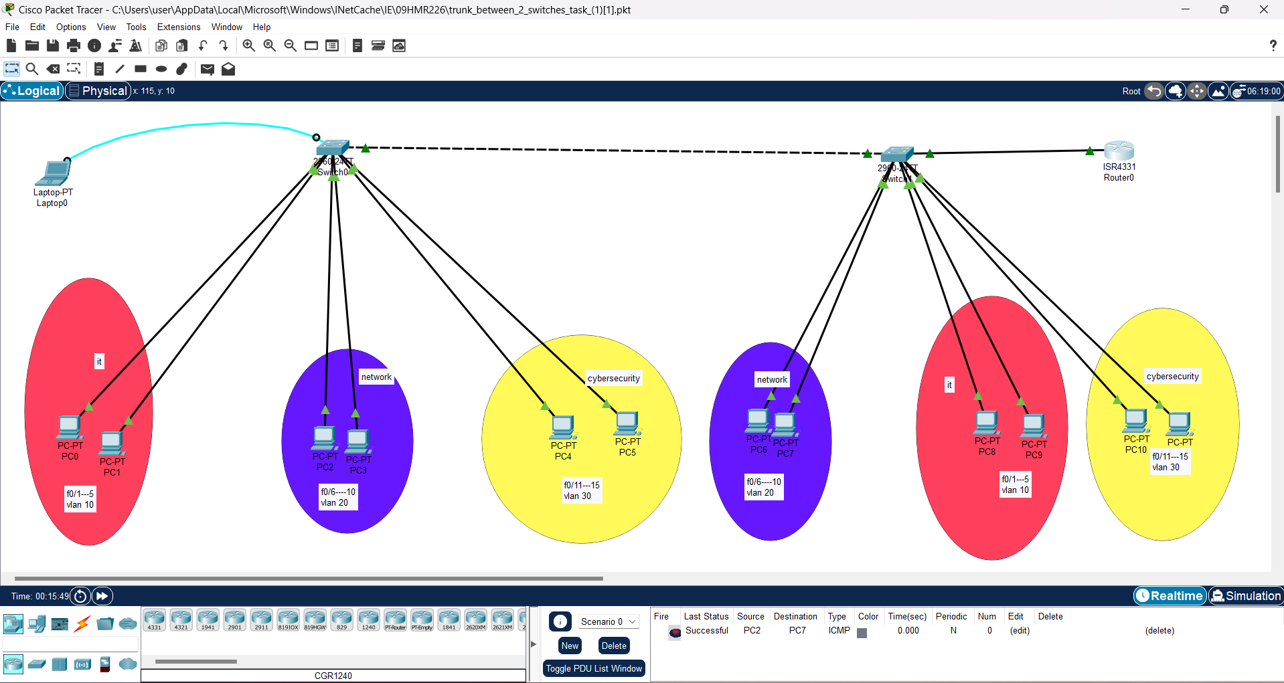
Week 1: Network Design and Configuration

Slide 3
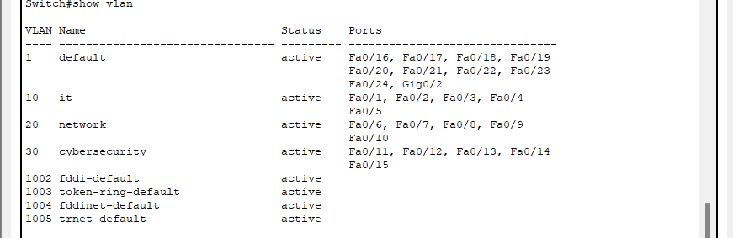
Week 2: VLANs and Inter-VLAN Routing
First: configuring vlan steps →in global
1-vlan …
2-name …
3- exit
Second: defining interface ranges for
each vlan → in global
1- interface range f0/1-….
2- switchport mode access
3- switchport access vlan …

Slide 4
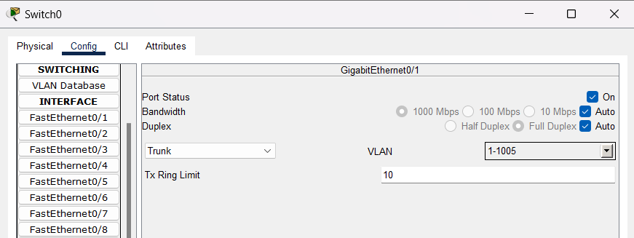
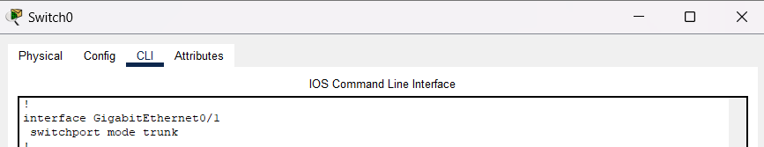
Third: making trunking to enable the similar vlans to connect
1- choose a cable to use as a trunk as(g0/1)
2-switchport mode trunk
F
ff

Slide 5
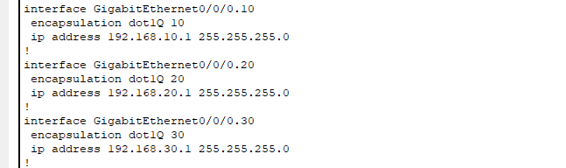
Fourth:Router on a stick vlan routing configuration
encapsulation dot1Q → is the subinterface tagging

Slide 6
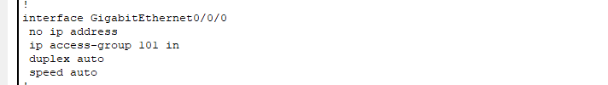
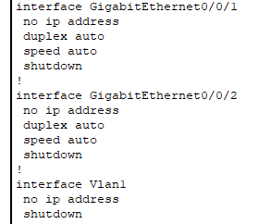

Week 3: Network Security Implementation
ACL: access control list
Shutdown:closing unused ports

